Slide 1
Mini project- by SHASHANK BHATT-02 VIVEK RATHOD-19 AADI RAUT-21 VEDANT PATIL-11

Slide 2
Title: Student Admission Council.
Description:
The MHTCET Counseling Admissions Process System developed an advanced software application designed to automate and streamline the admission counseling process for candidates appearing for Maharashtra Common Entrance Test (MHTCET). The system aims to provide a user-friendly interface for students, counselors, and administrators, facilitating a seamless and efficient admissions process.

Slide 3
Module Description:-
Student Admission Council Website
The Student Admission Council website is a comprehensive online platform designed to assist students and applicants in their college selection process, providing essential features and resources:
Search Bar:
The website features a user-friendly search bar, allowing visitors to search for information about colleges, courses, or any specific details they're interested in. Users can enter keywords or criteria to access relevant information quickly.
Study Material:
The website offers a dedicated section for study materials. Here, students can access various educational resources, including study guides, sample papers, and educational content related to their academic pursuits. This section supports their learning and preparation for admissions.

Slide 4
.
College Reviews:
The College Reviews section is an invaluable resource for prospective students. It's structured across three pages and contains comprehensive and detailed insights into various colleges. Users can access reviews, ratings, and comments provided by current and former students, offering a firsthand look at the college experience.
Cutoff Lists:
The Cutoff Lists section presents an organized collection of admission cutoff scores for multiple colleges and universities. Users can navigate through a list of institutions and departments to review the minimum scores required for admission. This information is crucial for applicants in making informed decisions about where to apply.
The Student Admission Council website is dedicated to streamlining the college selection process and supporting the academic endeavors of students. It serves as a valuable resource for research, preparation, and decision-making, ultimately assisting individuals in achieving their educational goals.

Slide 5
Brief description of software used and its programming
Frontend Development:
HTML (HyperText Markup Language): HTML is the core markup language used for creating the structure and content of web pages. In your website, HTML is employed to define the layout, headings, paragraphs, links, forms, and other elements necessary for presenting information to users.
CSS (Cascading Style Sheets): CSS is used to enhance the visual presentation of your website. It styles the HTML elements by specifying attributes like colors, fonts, margins, and padding. It's crucial for ensuring a visually appealing and consistent design

Slide 6
Backend Development:
JavaScript: JavaScript is a versatile scripting language used for the website's backend. It plays several critical roles, including:
Data Storage: JavaScript enables you to store and manage information about colleges, reviews, and cutoff lists.
Interactivity: JavaScript allows for dynamic interactions on the website, such as handling user input, responding to search queries, and loading content on demand
Study Material Section: JavaScript can be used to create interactive features for the study material section, allowing users to browse and access educational resources

Slide 7
Conclusion:
The JEE and MHTCET Counseling Admissions Process System is a powerful and efficient tool that simplifies the complex admission counseling process for students, counselors, and administrators alike. With its user-friendly interface, real-time updates, and comprehensive features, the system significantly reduces manual intervention, saves time, and ensures a transparent and fair allocation of seats. It plays a pivotal role in optimizing the admissions process, ultimately contributing to the smooth functioning of educational institutions and the academic growth of students.

Slide 8
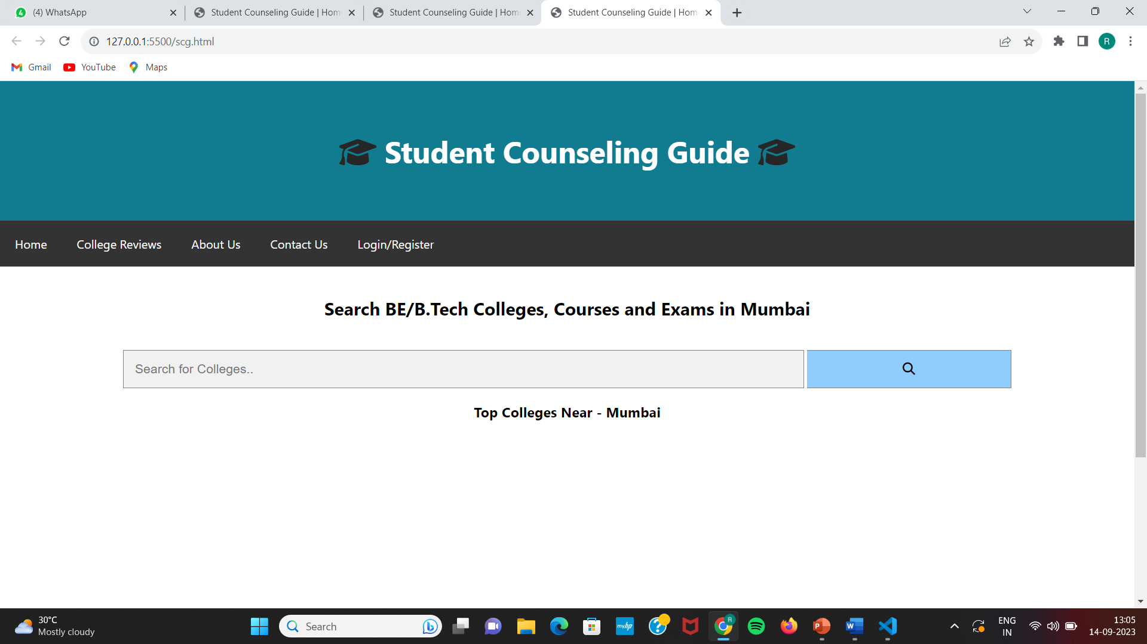

Slide 9
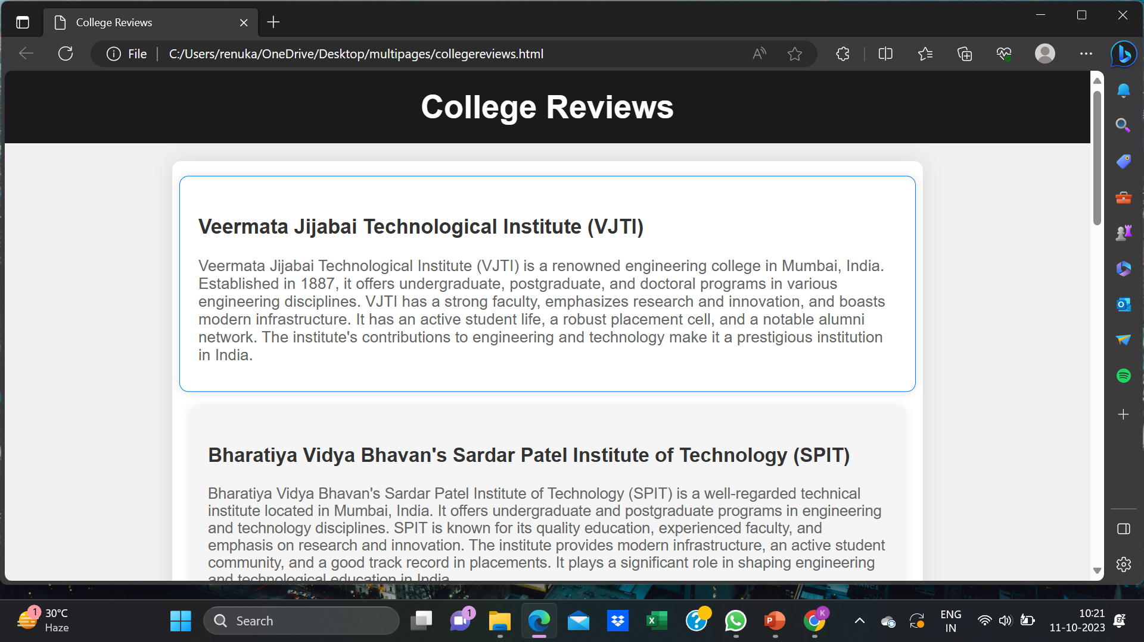

Slide 10
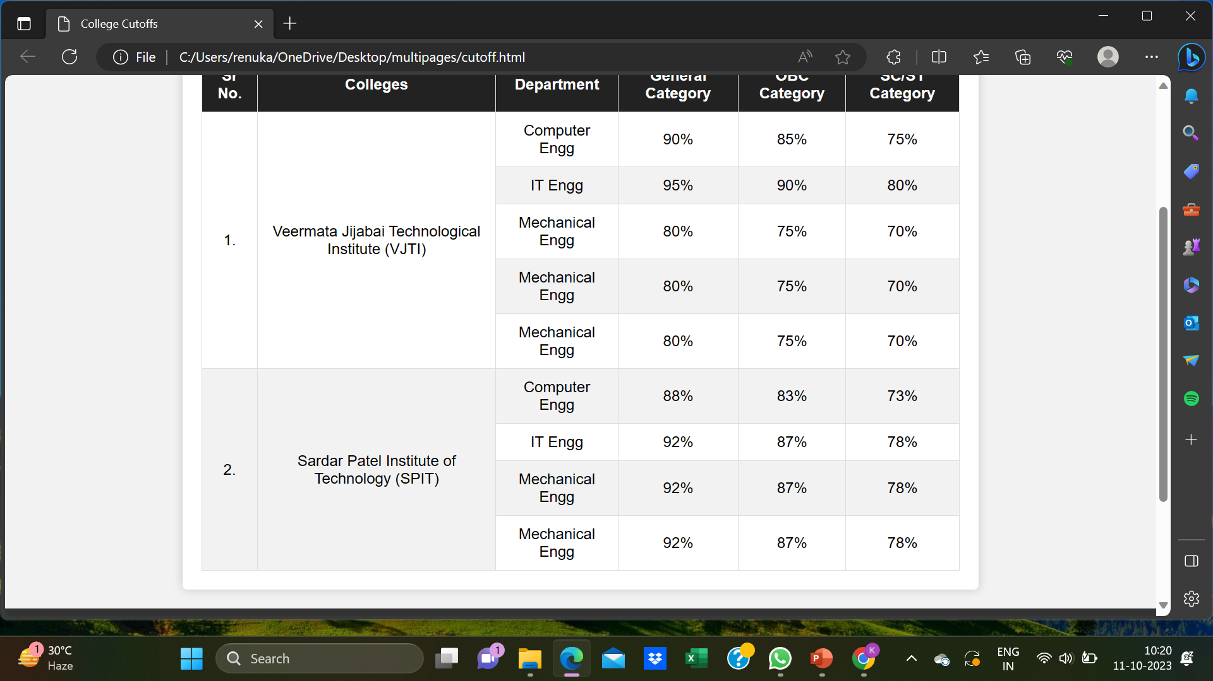

Slide 11
